Slide 1

Dawood university of engineering and technology Karachi
Group Members:
25F-AI-055(Laiba Arshad)
25F-AI-056(Uzair Ahmed)
25F-AI-090(Aisha Iqbal)
Subject: Presentation on the Life of Allama Iqbal

Slide 2
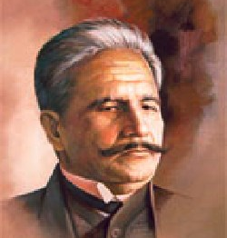
Allama Muhammed Iqbal
This Photo by Unknown Author is licensed under CC BY

Slide 3
Contents
1.Biography
2.Introduction
3. Stages of Life of Allama Iqbal
4.Works by Allama Iqbal
(Persian Books by Iqbal
Urdu Books by Iqbal)
5.Few poetic lines by Allama Iqbal
6.Famous Saying by Iqbal (Quotes)
7.Allama Iqbals Allahabad address.
8. Importance Of Allama Iqbal's Allahabad Address 1930 to the Pakistan Movement.
9. Contribution of Allama Iqbal.
10. Iqbal And Idea Of Pakistan

Slide 4
Biography
Sir Muhammad Iqbal Indian poet, philosopher, politician, barrister, and scholar.
Name: Allama Muhammad Iqbal.
Date of Birth: 9 November 1877.
Place of Birth: Sialkot ,Punjab Province(British India ) now Punjab Pakistan .
Date of Death: 12 April 1938.
Place of death: Lahore ,Punjab province (British Raj) now Punjab Pakistan .
Ocupation : Poet, Philosopher, Politician, Barrister and Scholar.
Father : Shaikh Noor Muhammed.

Slide 5
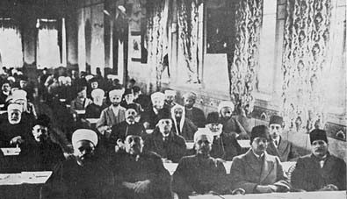
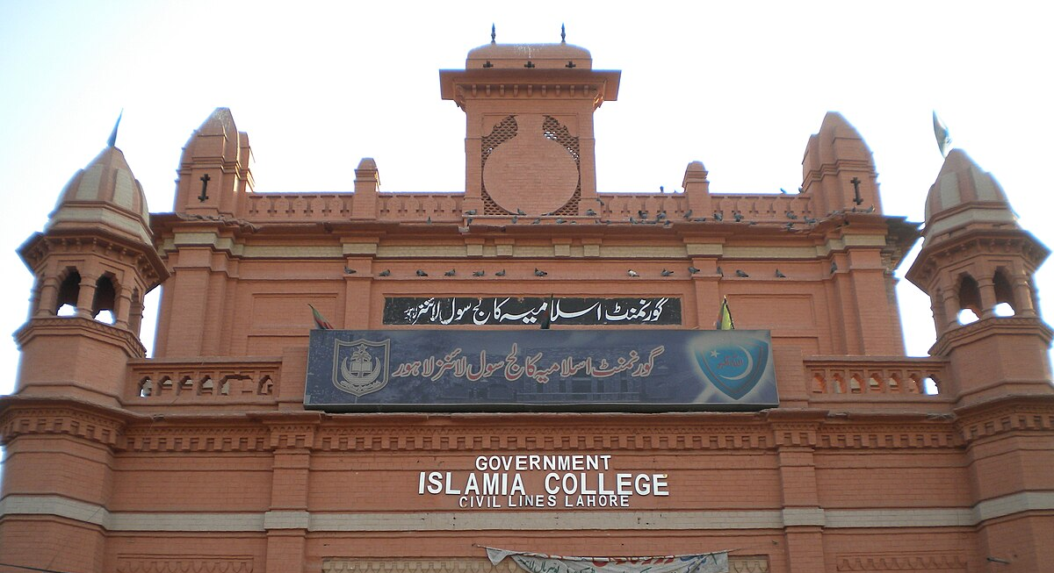
Introduction
Allama Iqbal was corn in a devout Muslim family in Sialkot . He received his early education in his hometown before moving to Lahore for higher education .Iqbal processed a keen intellect and demonstrated exceptional academic abilities from a young age .He completed his bachelors in philosophy ,followed by master’s degree in the same subject from government collage ,Lahore .
This Photo by Unknown Author is licensed under CC BY-SA
This Photo by Unknown Author is licensed under CC BY-SA

Slide 6
In 1908, Iqbal returned from England and joined again the Government college Lahore as a professor of philosophy and English literature.
He devoted himself in literary works and became an active member of Anjuman-e-Himayat-e-Islam. In 1919, he became the general secretary of the organisation.
Iqbal's thoughts in his work primarily focus on the spiritual direction and development of human society, centered around experiences from his travels and stays in Western Europe and the Middle East. He was greatly influenced by Western philosophers such as Friedrich Nietzsche, Henri Bergson and Goethe.

Slide 7
The poetry and philosophy of Maulana Rumi putt the deepest influence on Iqbal's mind.
Iqbal began intensely concentrating on the study of Islam, the culture and history of Islamic civilization and its political future, while embracing Rumi as his guide.
He gave the Philosphical explanasion to ideology of Pakistan.
Iqbal had a great role in Muslim political movement. Iqbal had remained active in the Muslim League.

Slide 8

Five stages of Iqbal's life 1877-1938
First stage of Iqbal’s life1877 to 1905
Early education from Sialkot and later went to GC Lahore.
Early Poetry-
Tarana-i-Hindi in hid Poem Himala,He talked about Hindustan
Reflects patriotism and imagery of nature
Indian Nationalism-Love for country.

Slide 9
Second stage of Iqbal's life 1905 to 1908
Higher Education in Europe.
Phd from Germany.
Studied western culture and civilization and western thinkers
Love for Humanity-equality-liberty and humanity
Iqbal studied the nature or European society about whom he emphasized had lost spiritual and religious values ,these inspired Iqbal to write poems on historical and cultural heritage of Islam and Muslim community ,with the global perspective.
Iqbal advocates the entire Muslim community ,addressed as the Muslim Ummah to define personal, social and political existence by the values and teachings of Islam.

Slide 10
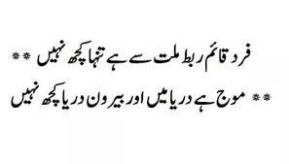
Third stage of Iqbal’s 1908 to 1918
Returned to india.
Love for country.
Poem
Watan Aik Siyasi Tasawar
He attended many musharas in Lahore.
Express his views in poetry.
He become famous poet in Lahore.

Slide 11
Fourth stage of Iqbal’s life 1918 to 1930
Became a practical politician.
Iqbal had a great role in Muslim political movement. Iqbal had remained active in Muslim League.
He did not support Indian involvement in World war 1,as well as the Khilafat Movement and remained in close touch with Muslim political leaders such as Maulana Muhammed Ali Jinnah.
He was a critic of the mainstream Indian national congress, which he regarded as dominated by Hindus and was disappointed with the League when during the 1920s it was fascinated in factional divides between the pro-British group led by Sir Muhammed Shafi and other group led by Jinnah.

Slide 12
Fifth stage of Iqbals life 1930 to 1938
Idea of Pakistan
Allahabad Address in 1930.
Concept of Two-nation theory.
In his presidential address on December 29, 1930, Iqbal outlined a vision of an independent state or states for Muslim-majority provinces in northwestern India, "I would like to see the Punjab, North-West Frontier Province, Sind and Baluchistan merged into a single state or states".

Slide 13

Works by Allama Iqbal

Slide 14


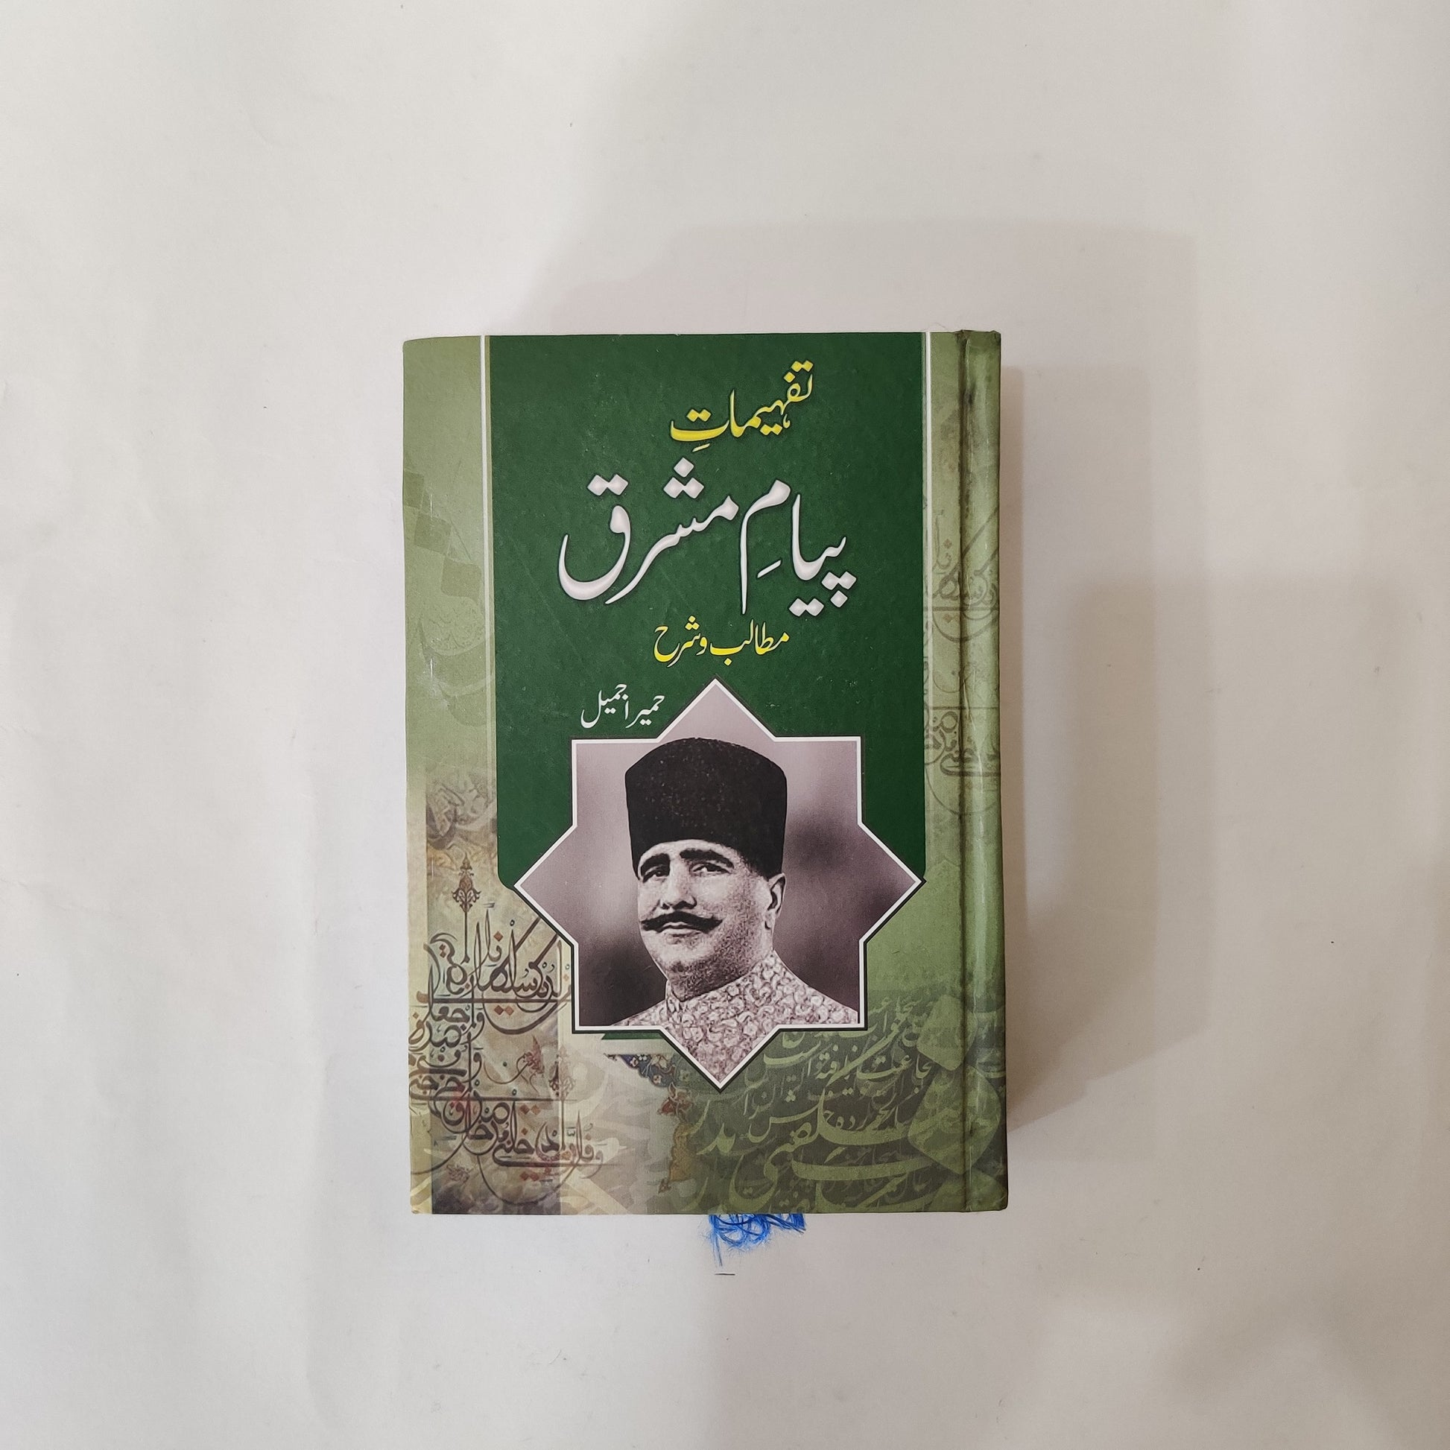
Persian Books by Iqbal Persian: Among his 12,000 verses of poetry, about 7,000 verses are in Persia 1915, he published his first collection of poetry book"The Secrets of the SelfAs Khudi" in Persian language.he published several poetry books in Persian langua whose names are
Asrar-e-Khudi(1915)
Rumuz-i-Bekhudi(1917)
Payam-i-Mashriq(1923)
Zabur-i-Ajam(1927)
Jawid Nama(1932)
Pas Cheh Bayed Kaed ai Aqwam-e-Sharq(1936)
Aemughan-e-Hajiz(1938)(in persian and Urdu)

Slide 15
Asrar-i-Khudi:-
it was the first philopsphical poetry book. There are 37 poems in
Asrar-i-Khudi poetry book
in Asrar-i-khudi poetry book Iqbal explains his philosophy of "Khudi", means "Self". Iqbal's use of the term "Khudi" is synonymous with the word "Rooh" which means soul used in the Quran for a divine spark which is present in every human being, and was said by Iqbal to be present in Adam, for which God ordered all of the angels to prostrate in front of Adam. Iqbal condemns self-destruction. For him, the aim of life is self-realization and self-knowledge. He charts the stages through which the "Self" has to pass before finally arriving at its point of perfection, enabling the knower of the "Self" to become a vice-regent of God
A few lines translated from Khudi in English by Reynold A.Nicholson:-
THE form of existence is an effect of the Self
Whatsoever thou seest is a secret of the self
It revealed the universe of Thought.
A hundred words are hidden in its essence
When the Self awoke to consciousness Self-affirmation brings Not-self to light
By the Self the seed of opposition is sown in the word
It imagines itself to be other than itself

Slide 16
Rumuz-i-Bekhudi:-Hints of Selflessness): Rumuz-e-Bekhudi was the second philosophical poetry book of Allama Iqbal
In Ramuz-i-Bekhudi Iqbal seeks to prove the Islamic way of life is the best code of conduct for a nation's viability. A person must keep his characteristics intact, he asserts, but once this is achieved, he should sacrifice his ambitions for the needs of the nation. Man cannot realize the "Self" outside of society. Published in 1917, this group of poems has as its main themes the ideal community, Islamic ethical and social principles, and the relationship between the individual and society. Although he supports Islam, Iqbal also recognises the positive aspects of other religions. Rumuz-i-Bekhudi complements the emphasis on the self in Asrar-e-Khudi and the two collections are often put in the same volume under the title Asrar-i-Rumuz (Hinting Secrets). It is addressed to the world's Muslims
A few poetic lines from Rumuz-i-Bekhudi translated by Reynold A. Nicholson .
“But yester-eve a lamp in hand
The Shaykh did all the city span,
Sick of mere ghosts he sought a man,
But could find none in all the land”

Slide 17
Payam-e-Mashriq:-it was 3rd philosophical poetry book writtend by Muhammad Iqbal and it was published in 1924
the Payam-e-Mashriq بیام مشرق)The Message of the East), is closely connected to the West-östlicher Diwan by the German poet Goethe. Goethe bemoans the West having become too materialistic in outlook, and expects the East will provide a message of hope to resuscitate spiritual values. Iqbal styles his work as a reminder to the West of the importance of morality, religion, and civilisation by underlining the need for cultivating feeling, ardor, and dynamism. He asserts that an individual can never aspire to higher dimensions unless he learns of the nature of spirituality. In his first visit to Afghanistan, he presented Payam-e Mashreq to King Amanullah Khan. In it, he admired the uprising of Afghanistan against the British Empire. In 1933, he was officially invited to Afghanistan to join the meetings regarding the establishment of Kabul University

Slide 18
Few poetic lines from Piyame Mashriq translated by Artur John Arberry
Successful head of a great monarchy,
Youthful in years, old in sagacity,
Inspired practitioner of the royal art,
Possessor of the wisdom of the heart,
With a will as strong as your mountain walls,
And constant circumspection that forestalls
All risks, ambition as high as my thought
, And organising power that has brought
Together feuding tribes, you have untold
Gifts made to you by kings silver and gold,
Rubies and jewels. O king, son of a king,
Accept from me this humble offering.
Ever since I found out life's mystery,
It is as if a fire blazed inside me.
My song is a flame of that inner fire
A song of passion sung on wisdom's lyre.
That Western sage, that bard of Germany
, That ardent lover of things Pahlavi
, Saluted the East with his great Divan,

Slide 19
Zabur-e-Ajam:- (Persian Psalms) this philosophical book was published in 1927
This book includes the poems "Gulshan-e-Raz-e-Jadeed" ("Garden of New Secrets") and "Bandagi Nama" ("Book of Slavery"). In "Gulshan-e-Raz-e-Jadeed", Iqbal first poses questions, then answers them with the help of ancient and modern insight. "Bandagi Nama" denounces slavery and attempts to explain the spirit behind the fine arts of enslaved societies. Here, as in other books, Iqbal insists on remembering the past, doing well in the present and preparing for the future, while emphasising love, enthusiasm and energy to fulfill the ideal life.

Slide 20
Jawad Nama:- جاوید (Book of Javed)
this philosophical poetry book he wrote for his son name "Javed Iqbal" & is named after and in a manner addressed to his son, who is featured in the poems. It follows the examples of the works of Ibn Arabi and Dante's The Divine Comedy, through mystical and exaggerated depictions across time. Iqbal depicts himself as Zinda Rud ("A stream full of life") guided by Rumi, "the master", through various heavens and spheres and has the honour of approaching divinity and coming in contact with divine illuminations. Iqbal depicts Rumi as a character and gives an exposition of the mysteries of Islamic laws and Sufi perceptions. Iqbal laments the dissension and disunity among the Indian Muslims as well as Muslim nations. "Musafir" is an account of one of Iqbal's journeys to Afghanistan, in which the Pashtun people are counselled to learn the "secret of Islam" and to "build up the self" within themselves.
Few translated poetic lines from Jawad Nama:-
I asked him, "What is the existent, the non-existent?
What is the meaning of praiseworthy and unpraiseworthy?"
He said, 'The existent is that which wills to appear: manifestation is all the impulse of Being. Life means to adorn oneself in one's self, to desire to bear witness to one's own being; the concourse on the day primordial arrayed desired to bear witness to their own being Whether you be alive, or dead, or dying for this seek witness from three witnesse The first witness is self-consciousness, to behold oneself in one's own light
the second witness is the consciousness of another, to behold oneself in another's light;
the third witness is the consciousness of God's essence to behold oneself in the light of God's essence. If you remain fast before this light count yourself living and abiding as God!
Life is to attain one's own station,
Life is to see the Essence without a veil; the true believer will not make do with Attributes

Slide 21

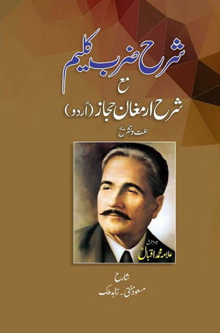

Urdu Books by Iqbal
Bag-i-Dara
Bal-i-Jibril
Zarb-i-Kalim
Armughan-e-Hijaz
“The reconstruction of Islamic religious thoughts in Islam”.(Series of lectures in different educational institutions that were later on published by Oxford press)

Slide 22
Bang-i-Dara
The Call of the Marching Bell), his first collection of Urdu poetry, was published in 1924. It was written in three distinct phases of his life. The poems he wrote up to 1905-the year he left for England-reflect patriotism and the imagery of nature, including the" Tarana-e-Hindi (The Song of India") and "Taranase Milli" ("The Song of the Community"). The second set of poems date from 1905-1908, when Iqbal studied in Europe, and dwell upon the nature of European society, which he emphasised had lost spiritual and religious values. This inspired Iqbal to write poems on the historical and cultural heritage of Islam and the Muslim community, with a global perspective. Iqbal urges the entire Muslim community, addressed as the Ummah, to define personal, social and political existence by the values and teachings of Islam.

Slide 23
Bal-e-Jibril(Wings of Gabriel):-It was published in 1935
Bat-e-Jibril جبرينngs of Gabriel) is considered by many critics as his finest Urdu poetry and was inspired by his visit to Spain, where he visited the monuments and legacy of the kingdom of the Moors. It consists of ghazals, poems, quatrains and epigrams and carries a strong sense of religious passion

Slide 24
Zarb-i-Kalim:- (The Rod of Moses)
It is is another philosophical poetry book of Allama Iqbal in Urdu, it was published in 1936, two years before his death. In which he described as his political manifesto. It was published with the subtitle "A Declaration of War Against the Present Times. Muhammad Iqbal argues that modern problems are due to the godlessness, materialism and injustice of modern civilisation, which feeds on the subjugation and exploitation of weak nations, especially the Indian Muslims

Slide 25
Ilum-ul-Iqtisad:- It was another book written in urdu by Allama Muhammed Iqbal was published in 1903

Slide 26
Aemughan-e-Hijaz (The Gift of Hijaz)
Iqbal's final work was Armughan-e-Hijaz معار حجاز( )The Gift of Hijaz), published posthumously in 1938. The first part contains quatrains in Persian, and the second part contains some poems and epigrams in Urdu. The Persian quatrains convey the impression that the poet is travelling through the Hijaz in his imagination. The profundity of ideas and intensity of passion are the salient features of these short poems

Slide 27
Famous Dr Allama Muhammed Iqbal Sayings (Qoutes):
1). "people who have no hold over their process of thinking are likely to be ruined by liberty of thought.
2). "The alchemist of the West has turned stone into glass
But my alchemy has transmuted glass into flint Pharaohs of today have stalked me in vain“
3). Look at the evils of the world around you and protect yourself from them. Our teachers give all the wrong messages to our youth, since they take away the natural flare from the soul. Take it from me that all knowledge is useless until it is connected with your life, because the purpose of knowledge is nothing but to show you the splendors of yourself!"

Slide 28
4). The revealed and mystic literature of mankind bears ample testimony to the fact that religious experience has been too enduring and dominant in the history of mankind to be rejected as mere illusion. There seems to be no reason, then, to accept the normal level of human experience as fact and reject its other levels as mystical and emotional."
5). "Failure is not fatal until we surrender trying again is the key of glorious victory"
6). "The heart is like a mirror. Do not prevent it from being broken. It's breakage is more dearer in the sight of its maker [Allah], than its safety. Almighty Allah being indeed the Maker".
7). "The poet's nature is all searching, creator and nourisher of desire; the poet is like the heart in a people's breast, a people without a poet is a mere heap of clay. If the purpose of poetry is the fashioning of men, poetry is likewise the heir of prophecy."
8). "What is the character and general structure of the universe in which we live? Is there a permanent element in the constitution of this universe? How are we related to it? What place do we occupy in it, and what is the kind of conduct that befits the place we occupy? These questions are common to religion, philosophy, and higher poetry".

Slide 29
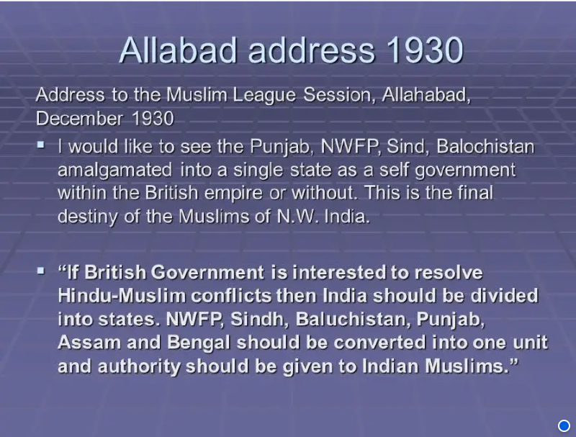
Allama Iqbals Allahabad Address 1930

Slide 30
Importance Of Allama Iqbal's Allahabad Address 1930 to the Pakistan Movement
In his address, Iqbal stressed that Muslims are a separate nation and they should have a unique representation of their cultural and religious identity. Allama Iqbal strongly supported the Two Nation Theory and said that there was no possibility of peace in the sub-continent unless Muslims were recognised as a separate nation.
He explained that since Islam is a complete code of life and guides the Muslims in every field, therefore Muslims in India needed a homeland where they could freely profess their religion and mould their lives in accordance with the principles of Islam
Thus Iqbal's views helped the Muslims to determine a line of action and work out a definite plan in order to achieve the goal of a separate homeland. Iqbal's Allahabad address importance lies in the fact that it was the first time that the idea of a separate Muslim state was expressed from Muslim League platform.
The Lahore Resolution of 1940 was also based upon the ideas expressed in the Allahabad Address of 1930. Allama Iqbal's influence and contribution to the ideology of Pakistan cannot be underestimated. In Lahore Resolution of 1940 the Muslims demanded a separate homeland which was the basis of the views of Allama Iqbal in his 1930 address of Allahabad.

Slide 31
Contribution of Allama Iqbal
He was the first important Muslim leader to advocate the partition of India and the creation of a separate Muslim state. As a result of his Allahabad address in 1930 when he put forward this view, separatism was seriously considered by many Muslims during the 1930s.
He was also opposed to the British control of India conquest of others was wrong and went against the Muslim faith. This strengthened his view that Muslims should have a separate homeland, independent of the British
He persuaded many Muslims that the Muslim League had to build an effective mass political party to challenge the domination of the Congress. This argument was adopted by Jinnah who went on to lead the Muslim League as a highly effective political party.
His poetry awakened a sense of nationhood among Muslims, and he urged them to be active in making progress. This progress needed to be along a distinctive Islamic path and not capitalist in nature. Again this vision was adopted by Muslims as a view of the future.

Slide 32
Iqbal And Idea Of Pakistan
Advocacy for Muslim identity and Rights:Iqbal was deeply concerned about the future of Muslims in India. He believed that Muslims were not just a minority community but a distinct nation with their own cultural, religious, and historical identity. He argued that the political and social interests of Muslims could not be safeguarded in a Hindu-majority India. Iqbal's emphasis on the distinct identity and rights of Muslims laid the groundwork for the demand for a separate nation.
Vision of an Islamic State:Iqbal envisioned a state where Islamic principles and values would guide governance and society. He believed that Islam provided a complete code of life, which could not be fully realized within a secular, Hindu-majority state. Iqbal's philosophical and poetic works, such as "The Reconstruction of Religious Thought in Islam" and his famous poem "Tarana-e-Milli," reflect his vision of an Islamic state where Muslims could live according to their faith and values.
Influence on the Muslim League and Jinnah: Iqbal's ideas significantly influenced the All-India Muslim League and its leader, Muhammad Ali Jinnah. While Iqbal did not live to see the creation of Pakistan, his correspondence with Jinnah in the 1930s played a crucial role in convincing Jinnah of the need for a separate Muslim state. Iqbal encouraged Jinnah to assume leadership of the Muslim League and to work towards the goal of an independent Muslim State.

Slide 33
4. Recognition by Contemporaried:Contemporaries and subsequent historians have widely recognized Iqbal's role in conceptualizing the idea of Pakistan. He is often referred to as the "Spiritual Father of Pakistan" for his contributions to the ideological foundation of the country. His ideas provided the intellectual and philosophical justification for the demand for a separate state.
5. Cultural and Literacy Influence: Iqbal's poetry and writings deeply influenced the Muslim psyche in India. His works emphasized the revival of Islamic values, self-respect, and empowerment among Muslims. Through his literary contributions, he inspired a sense of unity and purpose among Muslims, which was crucial in mobilizing support for the creation of Pakistan.
While the actual creation of Pakistan in 1947 involved many leaders, events, and negotiations, Iqbal's intellectual and ideological contributions laid the foundation for the concept of a separate Muslim state in the subcontinent. His vision, articulated through his speeches, writings, and correspondence, played a pivotal role in shaping the demand for Pakistan.

Slide 34
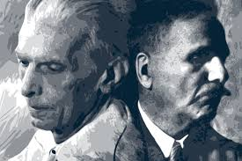
Jinnah and Iqbal
Iqbal came to believe that only Quaid-i-Azam Muhammed Ali Jinnah was a political leader capable of preserving this unity and fulfilling the Leagues objective on Muslim political impowerment.
Building a strong personal association with Jinnah,Iqbal was an influential force in convincing Jinnah to end his self-imposed exile in London ,return to india and take charge of the League.

Slide 35
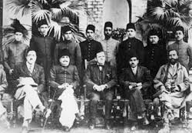
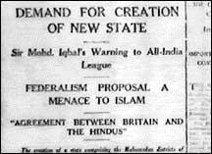
Idea of Pakistan by Iqbal
In his presidential address on December 29,1930 Iqbal outlined a vision of an independent state for Muslim majority provinces in northwestern India.
Quote: "I would like to see the Punjab, Northwest frontier province, Sindh and Balochistan merged into a single state. Self-government within the British Empire.”

